Slide 1

An “app” thought!

Slide 2
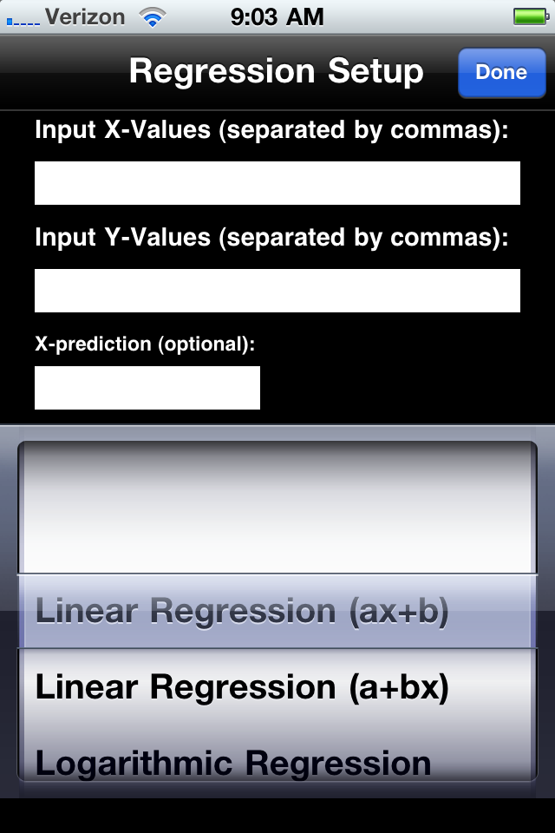
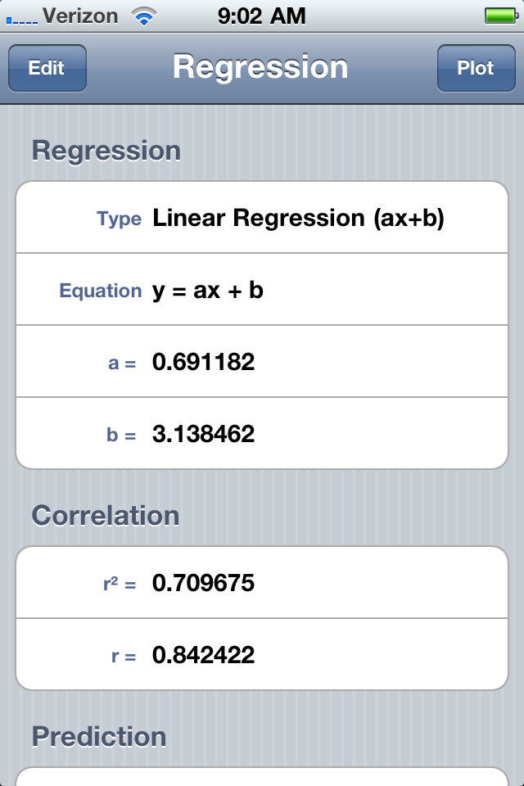
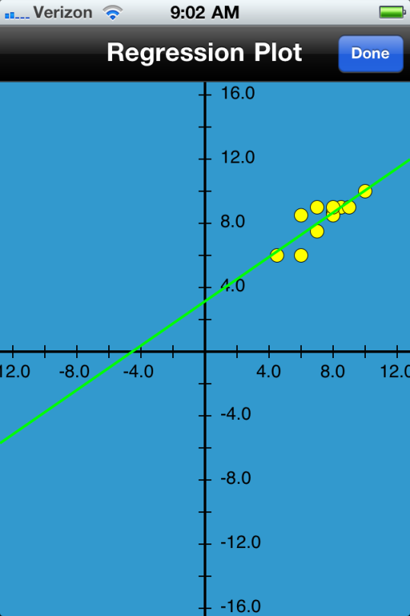

Slide 3
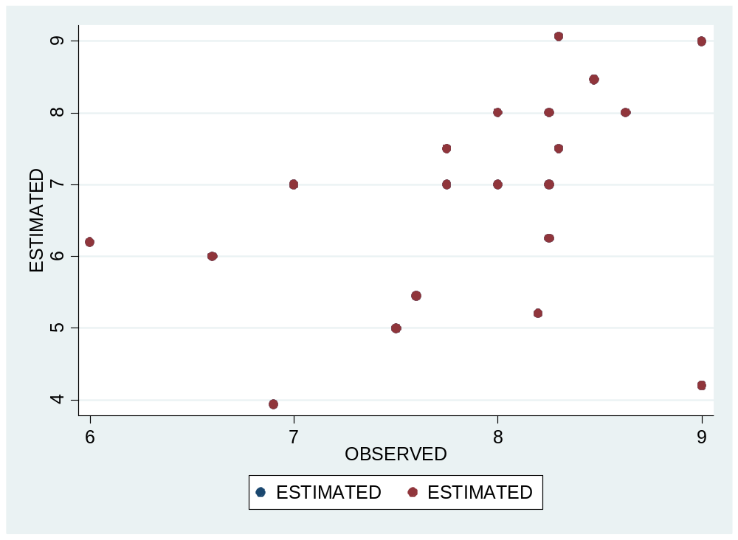

Slide 4
An “app” thought!
VC question: How much is this worth as a killer app?

Slide 5
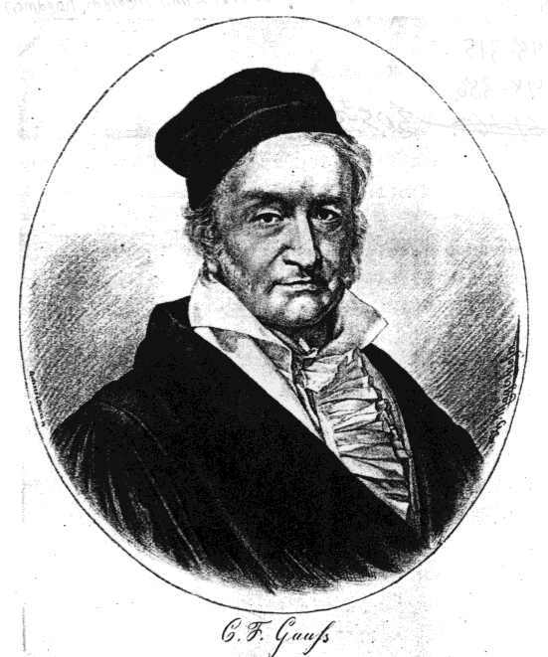
GAUSS, Carl Friedrich 1777-1855
http://www.york.ac.uk/depts/maths/histstat/people/

Slide 6
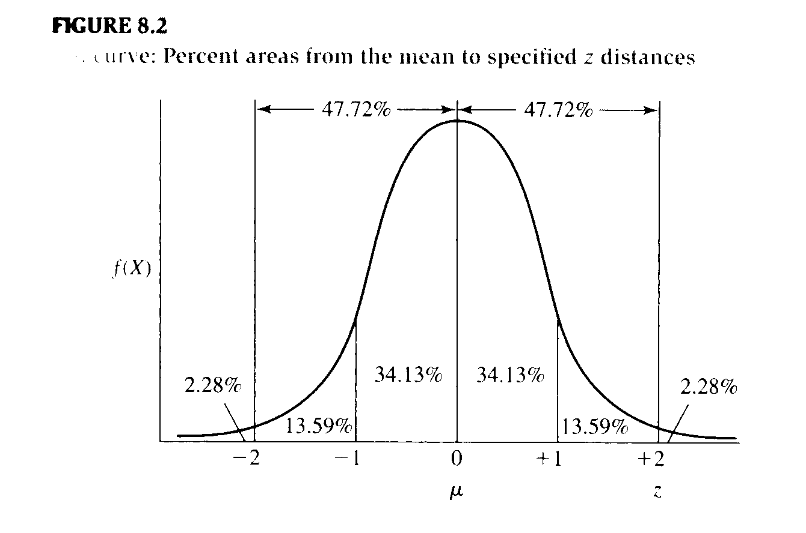
1
f(X) =
Where π = 3.1416 and e = 2.7183
e^{-(X - μ) / 2 σ}
2
2
σ 2π

Slide 7
Normal Distribution
Unimodal
Symmetrical
34.13% of area under curve is between µ and +1 σ
34.13% of area under curve is between µ and -1 σ
68.26% of area under curve is within 1 σ of µ.
95.44% of area under curve is within 2 σ of µ.

Slide 8
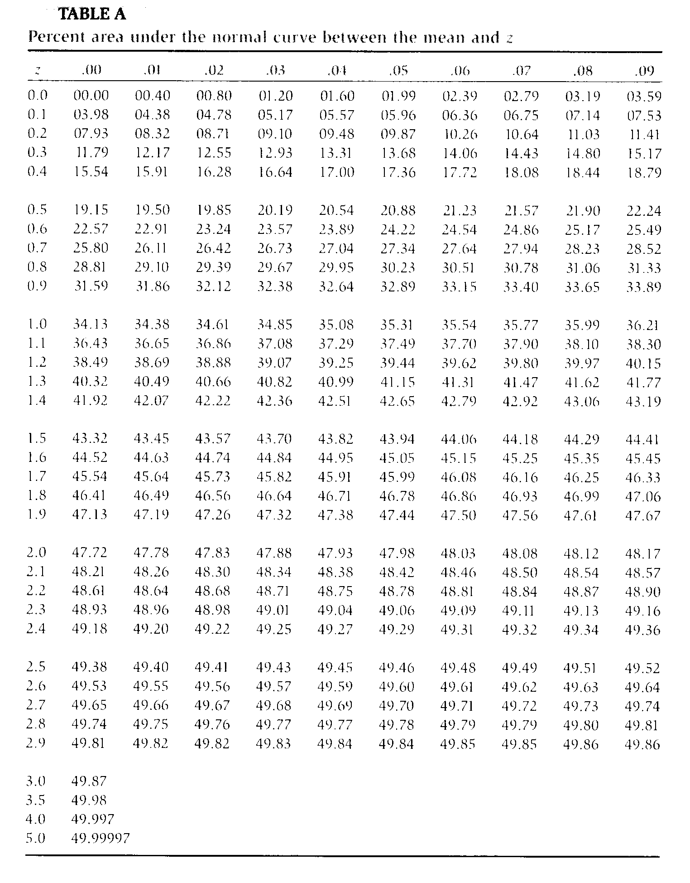

Slide 9
Some Problems
If z = 1, what % of the normal curve lies above it? Below it?
If z = -1.7, what % of the normal curve lies below it?
What % of the curve lies between z = -.75 and z = .75?
What is the z-score such that only 5% of the curve lies above it?
In the SAT with µ=500 and σ=100, what % of the population
do you expect to score above 600? Above 750?

Slide 10
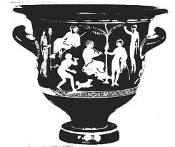
_
_
X
_
X
_
_
X
_
_
_
X
X
X
_
_
_
X
X
_
X
X
X
_
_
_
X
_
_
X
X
X
_
_
X
X
_
_
X
X
_
_
X
X
_
_
_
X
X
_
X
_
X
X
_
X
_
X
_
_
X
_
X
_
X
X
X
_
X
_
X
X
μ

Slide 11
Sample_{C}
X_{C}
_
Sample_{D}
X_{D}
s_{c}
_
n
s_{d}
Population
n
Sample_{B}
X_{B}
µ
σ
_
s_{b}
n
Sample_{E}
X_{E}
Sample_{A}
X_{A}
_
_
s_{e}
s_{a}
n
n
In reality, the sample mean is just one of many possible sample
means drawn from the population, and is rarely equal to µ.

Slide 12
Sample_{C}
X_{C}
_
Sample_{D}
X_{D}
s_{c}
_
n
s_{d}
Population
n
Sample_{B}
X_{B}
µ
σ
_
s_{b}
n
Sample_{E}
X_{E}
Sample_{A}
X_{A}
_
_
s_{e}
s_{a}
n
n
In reality, the sample sd is also just one of many possible sample
sd’s drawn from the population, and is rarely equal to σ
.

Slide 13
What’s the difference?
SS
SS
s²
σ²
=
=
(N - 1)
N

Slide 14
What’s the difference?
(occasionally you will see this little “hat” on the symbol to clearly indicate that this is a variance estimate) – I like this because it is a reminder that we are usually just making estimates, and estimates are always accompanied by error and bias, and that’s one of the enduring lessons of statistics)
SS
SS
^
s²
σ²
=
=
(N - 1)
N

Slide 15
Standard deviation.
SS
s
=
(N - 1)

Slide 17
As sample size increases, the magnitude of the sampling error decreases; at a certain
point, there are diminishing returns of increasing sample size to decrease sampling error.

Slide 18
Central Limit Theorem
The sampling distribution of means from random samples
of n observations approaches a normal distribution
regardless of the shape of the parent population.
Just for fun, go check out the Khan Academy
http://www.khanacademy.org/video/central-limit-theorem?playlist=Statistics

Slide 19
Wow! We can use the z-distribution to test a hypothesis.
_
X - μ
z =
-
σ_{X}

Slide 20
Step 1. State the statistical hypothesis H₀ to be tested (e.g., H₀: μ = 100)
Step 2. Specify the degree of risk of a type-I error, that is, the risk of incorrectly concluding
that H₀ is false when it is true. This risk, stated as a probability, is denoted by α, the probability
of a Type I error.
Step 3. Assuming H₀ to be correct, find the probability of obtaining a sample mean that
differs from μ by an amount as large or larger than what was observed.
Step 4. Make a decision regarding H₀, whether to reject or not to reject it.

Slide 21
An Example
You draw a sample of 25 adopted children. You are interested in whether they
are different from the general population on an IQ test (μ = 100, σ = 15).
The mean from your sample is 108. What is the null hypothesis?

Slide 22
An Example
You draw a sample of 25 adopted children. You are interested in whether they
are different from the general population on an IQ test (μ = 100, σ = 15).
The mean from your sample is 108. What is the null hypothesis?
H₀: μ = 100

Slide 23
An Example
You draw a sample of 25 adopted children. You are interested in whether they
are different from the general population on an IQ test (μ = 100, σ = 15).
The mean from your sample is 108. What is the null hypothesis?
H₀: μ = 100
Test this hypothesis at α = .05

Slide 24
An Example
You draw a sample of 25 adopted children. You are interested in whether they
are different from the general population on an IQ test (μ = 100, σ = 15).
The mean from your sample is 108. What is the null hypothesis?
H₀: μ = 100
Test this hypothesis at α = .05
Step 3. Assuming H₀ to be correct, find the probability of obtaining a sample mean that
differs from μ by an amount as large or larger than what was observed.
Step 4. Make a decision regarding H₀, whether to reject or not to reject it.

Slide 26
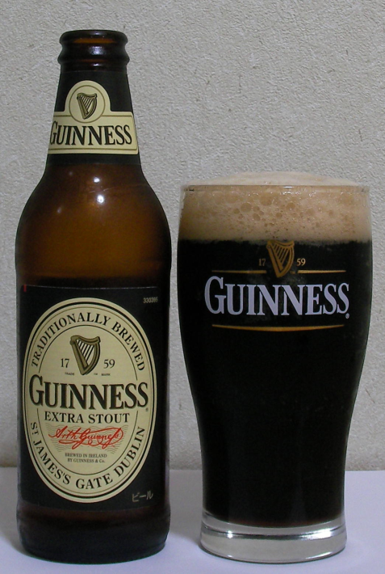

Slide 27
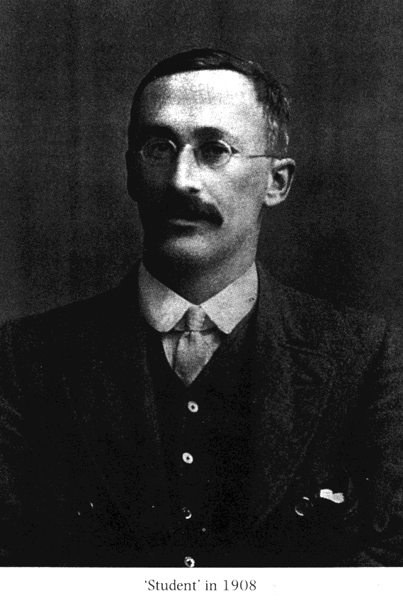
GOSSET, William Sealy 1876-1937

Slide 28


GOSSET, William Sealy 1876-1937

Slide 29
The t-distribution is a family of distributions varying by degrees of freedom (d.f., where
d.f.=n-1). At d.f. = ∞, but at smaller than that, the tails are fatter.

Slide 30
_
X - μ
z =
-
σ_{X}
_
X - μ
t =
-
s_{X}
s
-
s_{X} =
√ N

Slide 31
The t-distribution is a family of distributions varying by degrees of freedom (d.f., where
d.f.=n-1). At d.f. = ∞, but at smaller than that, the tails are fatter.

Slide 32
Degrees of Freedom
df = N - 1

Slide 33
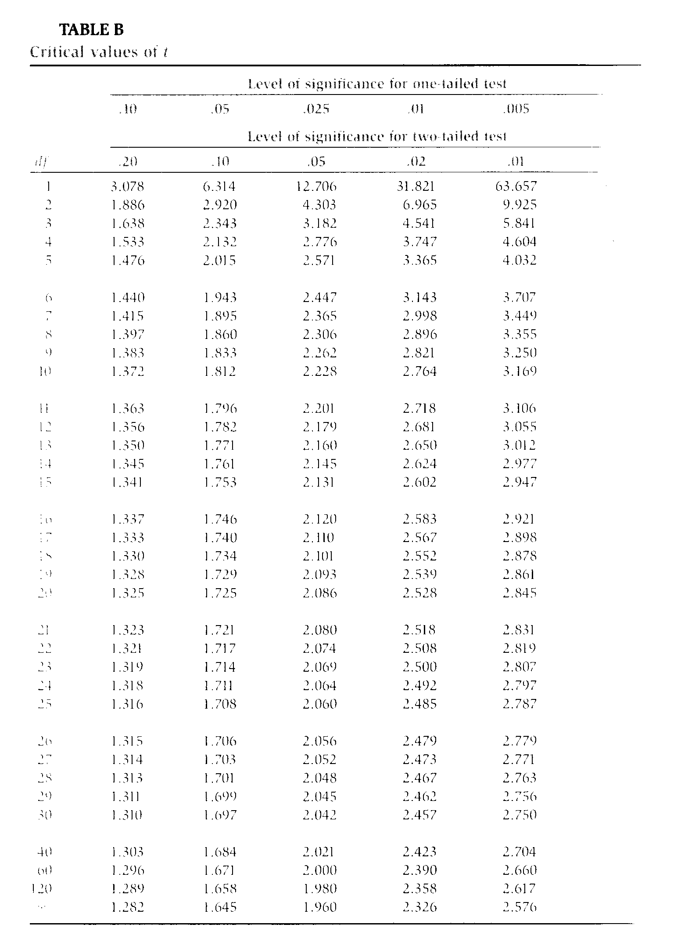

Slide 34
Problem
Sample:
Mean = 54.2
SD = 2.4
N = 16
Do you think that this sample could have been drawn from a population with μ = 50?

Slide 35
Problem
Sample:
Mean = 54.2
SD = 2.4
N = 16
Do you think that this sample could have been drawn from a population with μ = 50?
_
X - μ
t =
-
s_{X}

Slide 36
The mean for the sample of 54.2 (sd = 2.4) was significantly different from a hypothesized population mean of 50, t(15) = 7.0, p < .001.

Slide 37
The mean for the sample of 54.2 (sd = 2.4) was significantly reliably different from a hypothesized population mean of 50, t(15) = 7.0, p < .001.

Slide 38
Sample_{C}
Sample_{D}
r_{XY}
r_{XY}
Population
Sample_{B}
ρ_{XY}
r_{XY}
Sample_{E}
Sample_{A}
_
r_{XY}
r_{XY}

Slide 39
The t distribution, at N-2 degrees of freedom, can be used to test the probability that the statistic r was drawn from a population with ρ = 0. Table C.
H₀ : ρ _{XY} = 0
H₁ : ρ _{XY} ≠ 0
where
r N - 2
t =
1 - r²

